Slide 1

Graphs
C H A P T E R 18
So I draw the world together link by link: Yea, from Delos up to Limerick and back!
—Rudyard Kipling, “The Song of the Banjo,” 1894
18.1 The structure of a graph
18.2 Representation strategies
18.3 A low-level graph abstraction
18.4 Graph traversals
18.5 Defining a Graph class
18.6 Dijkstra’s Algorithm and Kruskal’s Algorithm
18.7 Other graph algorithms and applications

Slide 2
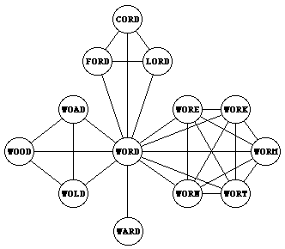
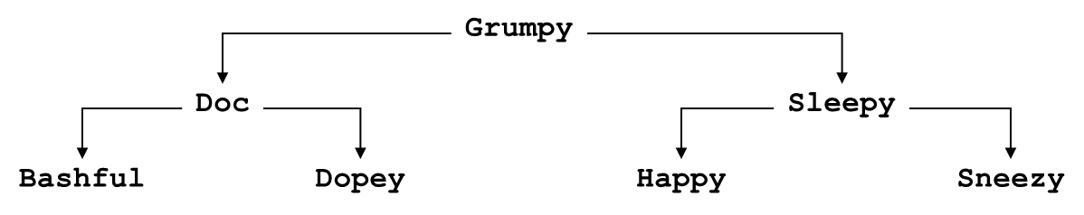
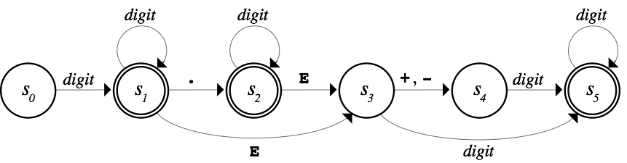


Examples of Graphs

Slide 3
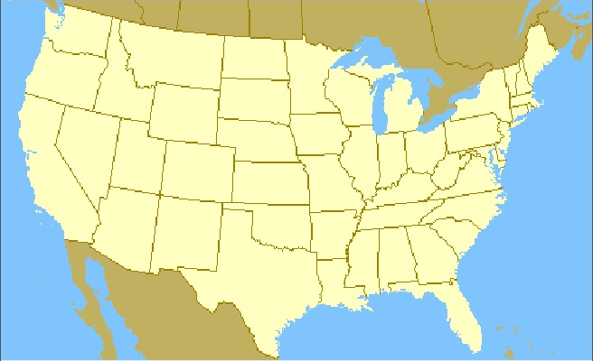
Example of Graphs
Seattle
Portland
Minneapolis
Boston
NewYork
SaltLakeCity
Chicago
SanFrancisco
WashingtonDC
Denver
KansasCity
LasVegas
Raleigh
LosAngeles
OklahomaCity
Phoenix
Atlanta
Dallas
NewOrleans
Orlando

Slide 4
The Definition of a Graph
A graph consists of a set of nodes together with a set of arcs. The nodes correspond to the dots or circles in a graph diagram (which might be cities, words, neurons, or who knows what) and the arcs correspond to the links that connect two nodes.
In some graphs, arcs are shown with an arrow that indicates the direction in which two nodes are linked. Such graphs are called directed graphs.
Other graphs, arcs are simple connections indicating that one can move in either direction between the two nodes. These graphs are undirected graphs.
Undirected Graph
Directed Graph

Slide 5
Graph Terminology
Mathematicians often use the words vertex and edge for the structures that computer scientists call node and arc. We’ll stick with the computer science names, but you might see their mathematical counterparts in algorithmic descriptions.
The nodes to which a particular node is connected are called its neighbors.
In an undirected graph, the number of connections from a node is called its degree. In a directed graph, the number of arcs leading outward is called the out-degree, and the number of arcs leading inward is called the in-degree.
A series of arcs that connect two nodes is called a path. A path that returns to its starting point is called a cycle. A simple path/cycle is a path/cycle without duplicated nodes.
A graph in which there is a path between every pair of nodes is said to be strongly connected. A directed graph is only weakly connected if its undirected counterpart is connected.

Slide 6
Graph Abstraction
Seattle
Portland
Minneapolis
Boston
NewYork
SaltLakeCity
Chicago
SanFrancisco
Denver
WashingtonDC
KansasCity
LasVegas
Raleigh
LosAngeles
OklahomaCity
Phoenix
Atlanta
Dallas
NewOrleans
Orlando

Slide 7
Graph Representations

Slide 8
Graph Representations
Like most abstract structures, graphs can be implemented in different ways. The primary feature that differentiates these implementations is the strategy used to represent connections between nodes. In practice, the most common strategies are:
Storing the connections for each node in an adjacency list.
Storing the connections for the entire graph in an adjacency matrix.
Storing the connections for each node as a set of arcs.

Slide 9
Graph Representations
Storing the connections for each node in an adjacency list.
Although simple and convenient, this representation can be inefficient when searching through the list of arcs associated with a node. If the nodes have a large number of neighbors, this cost, O(D), where D represents the degree of the originating node, becomes more significant.
Atlanta → (Chicago, Dallas, New York)
Boston → (New York, Seattle)
Chicago → (Atlanta, Denver)
Dallas → (Atlanta, Denver, Los Angeles)
Denver → (Chicago, Dallas, San Francisco)
Los Angeles → (Dallas)
New York → (Atlanta, Boston)
Portland → (San Francisco, Seattle)
San Francisco → (Dallas, Denver, Portland)
Seattle → (Boston, Portland)

Slide 10
Graph Representations
Storing the connections for the entire graph in an adjacency matrix.
Similar to the idea of lookup table, this representation reduces the cost of checking for connections to O(1). But the O(N²) storage space is inefficient for a sparse graph (i.e., D << N).

Slide 11
Graph Representations
Storing the connections for each node as a set of arcs.
This representation is conceptually simple and mirrors precisely the mathematical definition.
Finding neighbors for any node requires going through every arc, which needs a collection class that supports iteration.
Associating additional data with nodes and arcs requires using structures/classes to represent the nodes and arcs. E.g., many graph algorithms assign a numeric value to each of the arcs that indicates the cost of traversing that arc.
struct StringBasedGraph {
Set<string> nodes; /* Atlanta… */
Set<string> arcs; /* Atlanta_Chicago… */
};

Slide 12
The Low-Level graphtypes.h Interface
/*
* File: graphtypes.h
* ------------------
* This file defines low-level data structures that represent graphs.
*/
#ifndef _graphtypes_h
#define _graphtypes_h
#include <string>
#include "map.h"
#include "set.h"
struct Node; /* Forward references to these two types so */
struct Arc; /* that the C++ compiler can recognize them. */
/*
* Type: SimpleGraph
* -----------------
* This type represents a graph and consists of a set of nodes, a set of
* arcs, and a map that creates an association between names and nodes.
*/
struct SimpleGraph {
Set<Node *> nodes;
Set<Arc *> arcs;
Map<std::string,Node *> nodeMap;
};

Slide 13
The Low-Level graphtypes.h Interface
/*
* Type: Node
* ----------
* This type represents an individual node and consists of the
* name of the node and the set of arcs from this node.
*/
struct Node {
std::string name;
Set<Arc *> arcs;
};
/*
* Type: Arc
* ---------
* This type represents an individual arc and consists of pointers
* to the endpoints, along with the cost of traversing the arc.
*/
struct Arc {
Node *start;
Node *finish;
double cost;
};
#endif
/*
* File: graphtypes.h
* ------------------
* This file defines low-level data structures that represent graphs.
*/
#ifndef _graphtypes_h
#define _graphtypes_h
#include <string>
#include "map.h"
#include "set.h"
struct Node; /* Forward references to these two types so */
struct Arc; /* that the C++ compiler can recognize them. */
/*
* Type: SimpleGraph
* -----------------
* This type represents a graph and consists of a set of nodes, a set of
* arcs, and a map that creates an association between names and nodes.
*/
struct SimpleGraph {
Set<Node *> nodes;
Set<Arc *> arcs;
Map<std::string,Node *> nodeMap;
};

Slide 14
Graph Traversals
The process of visiting each node in a graph by moving along its arcs is called traversing the graph. At each node, a function visit can be called to perform some operations, e.g., simply printing the name of the node being visited.
The goal of a traversal is to call visit once, and only once, on every node in an order determined by the connections, which requires some structure to keep track of nodes that have already been visited. Common strategies are to include a visited flag in each node or to pass a set of visited nodes, as shown in the following code:
void visit(Node *node) {
cout << node->name << endl;
}
void depthFirstSearch(Node *node) {
Set<Node *> visited;
visitUsingDFS(node, visited);
}

Slide 15
Depth-First Search
The traversal strategy of depth-first search (or DFS for short) recursively processes the graph, following each branch, visiting nodes as it goes, until every node is visited.

Slide 16
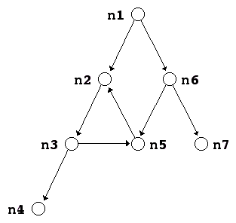
Breadth-First Search
The traversal strategy of breadth-first search (or BFS for short) proceeds outward from the starting node, visiting the start node, then all nodes one hop away, and so on.
For example, consider the graph:
Breadth-first search begins at the start node (n1), then does the one-hops (n2 and n6), then the two hops (n3, n5, and n7) and finally the three hops (n4).

Slide 17
Exercise: Breadth-First Search

Slide 18
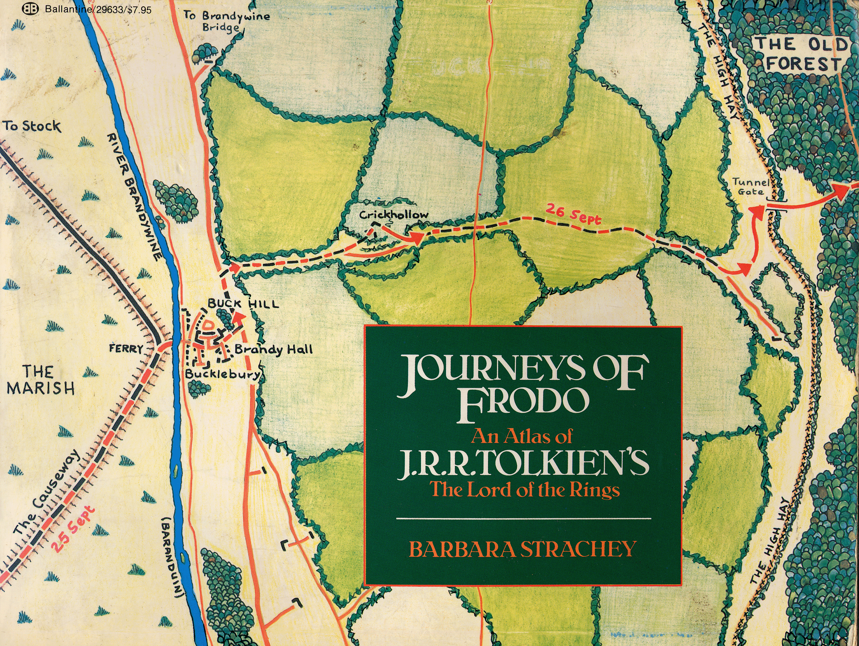
Example: Frodo’s Journey

Slide 19
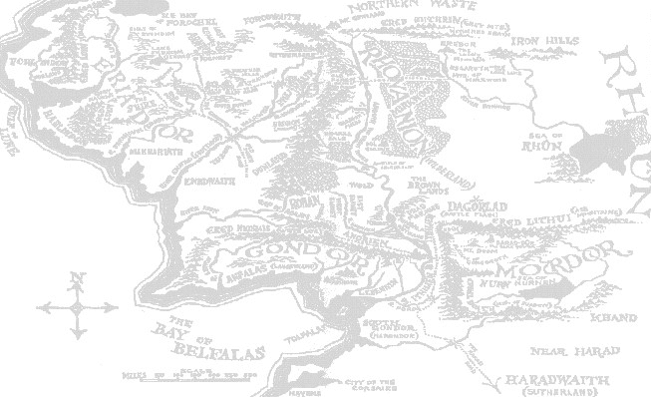
The Middle Earth Graph
Hobbiton
10
Bree
30
Rivendell
1
Southfarthing
10
30
Caradhras
Moria
30
50
40
Lorien
Isengard
10
5
50
10
Rauros
BlackGate
Edoras
20
15
70
15
20
MountDoom
MinasTirith
30
40
CirithUngol

Slide 20
Exercise: Depth-First Search
Construct a depth-first search starting from Hobbiton (HOB):
BRE
Visiting node HOB
Visiting node BRE
Visiting node RIV
Visiting node CAR
Visiting node LOR
Visiting node EDO
Visiting node ISE
Visiting node SOU
Visiting node MIN
Visiting node CIR
Visiting node BLA
Visiting node MOU
Visiting node RAU
Visiting node MOR
HOB
RIV
SOU
CAR
MOR
LOR
ISE
EDO
RAU
BLA
MOU
MIN
CIR
What data structure should we use?
Stack. Or even better, the stack frame by using recursion.

Slide 21
Exercise: Breadth-first search
Construct a breadth-first search starting from Isengard (ISE):
BRE
Visiting node ISE
Visiting node EDO
Visiting node SOU
Visiting node LOR
Visiting node MIN
Visiting node RAU
Visiting node HOB
Visiting node CAR
Visiting node MOR
Visiting node CIR
Visiting node BLA
Visiting node BRE
Visiting node RIV
Visiting node MOU
HOB
RIV
SOU
CAR
MOR
LOR
ISE
EDO
RAU
BLA
MOU
MIN
CIR
What data structure should we use?
Queue:
ISE
EDO
SOU
LOR
MIN
RAU
HOB
CAR
MOR
CIR
BLA
BRE
RIV
MOU

Slide 22
Depth-First Search Using Recursion
void depthFirstSearch(Node *node) {
Set<Node *> visited;
visitUsingDFS(node, visited);
}
void visitUsingDFS(Node *node, Set<Node *> & visited) {
if (visited.contains(node)) return;
visit(node);
visited.add(node);
for (Arc *arc : node->arcs) {
visitUsingDFS(arc->finish, visited);
}
}
Exercise: Eliminate the recursion by using a stack.

Slide 23
Breadth-First Search Using a Queue
void breadthFirstSearch(Node *node) {
Set<Node *> visited;
Queue<Node *> queue;
queue.enqueue(node);
while (!queue.isEmpty()) {
node = queue.dequeue();
if (!visited.contains(node)) {
visit(node);
visited.add(node);
for (Arc *arc : node->arcs) {
queue.enqueue(arc->finish);
}
}
}
}

Slide 24
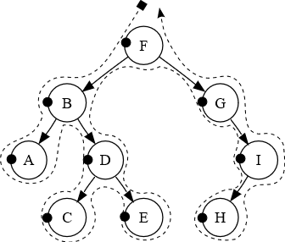
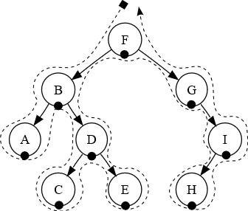
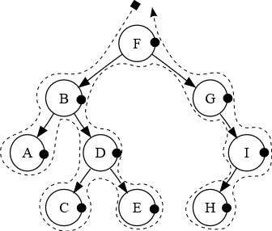
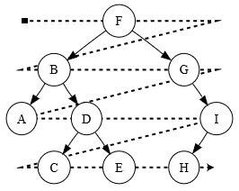
Exercise: Tree Traversal
Pre-order: F, B, A, D, C, E, G, I, H.
In-order: A, B, C, D, E, F, G, H, I.
Post-order: A, C, E, D, B, H, I, G, F.
Level-order: F, B, G, A, D, I, C, E, H.

Slide 25
Designing a Graph Interface
To take maximum advantage of the intuition that people have with graphs, it makes sense to design a graph package in C++ so that it adheres as closely as possible to the way in which graphs are defined in mathematics. In particular, the idea that a graph is a set of nodes together with a set of arcs should be clear from the definition.
Both nodes and arcs have some properties that are closely tied to the graph in which they belong. Each node, for example, must keep track of the arcs that lead to its neighbors. In much the same way, each arc needs to know what nodes it connects.
At the same time, both nodes and arcs are likely to contain other information that depends on the application, such as the name of a node or the cost of traversing an arc.

Slide 26
Three Strategies for Graph Abstraction
1. Use low-level structures. This design uses the structure types Node and Arc to represent the components of a graph. This model gives clients complete freedom to extend these structures but offers no support for graph operations.
2. Define classes for each of the component types. This design uses the Node and Arc classes to define the structure. In this model, clients define subclasses of the supplied types to particularize the graph data structure to their own application. More will be discussed later when we learn inheritance.
3. Adopt a hybrid strategy. This design defines a Graph class as a parameterized class using templates so that it can use any structures or objects as the node and arc types. This strategy retains the flexibility of the low-level model and avoids the complexity associated with the class-based approach.

Slide 27
Graph as a parameterized class
The basic idea behind this design is to export a parameterized Graph class that lets the client choose types for the nodes and arcs. Those types must adhere to a few basic rules that allow them to function correctly in the context of a graph. These required fields are essentially the ones that appear in the low-level structures.
The type the client chooses to represent a node must contain
A string field called name that specifies the name of the node
A field called arcs that specifies the set of arcs that begin at this node
The type chosen to represent an arc must contain
Fields called start and finish that indicate the endpoints of the arc
Beyond the required fields, the types used to represent nodes and arcs may contain additional information required for the client’s application.

Slide 28
The class-based graph.h Interface
/*
* File: graph.h
* -------------
* This interface exports a parameterized Graph class used to represent
* graphs, which consist of a set of nodes and a set of arcs.
*/
#ifndef _graph_h
#define _graph_h
#include <string>
#include "error.h"
#include "map.h"
#include "set.h"
/*
* Functions: nodeCompare, arcCompare
* ----------------------------------
* Standard comparison functions for nodes and arcs.
*/
template <typename NodeType>
int nodeCompare(NodeType *n1, NodeType *n2);
template <typename NodeType,typename ArcType>
int arcCompare(ArcType *a1, ArcType *a2);

Slide 29
The class-based graph.h Interface
/*
* Class: Graph<NodeType,ArcType>
* ------------------------------
* This class represents a graph with the specified node and arc types.
* The NodeType and ArcType parameters indicate the structure type or class
* used for nodes and arcs, respectively. These types can contain any
* fields or methods required by the client, but must contain the following
* public fields required by the Graph package itself:
*
* The NodeType definition must include:
* - A string field called name
* - A Set<ArcType *> field called arcs
*
* The ArcType definition must include:
* - A NodeType * field called start
* - A NodeType * field called finish
*/
template <typename NodeType,typename ArcType>
class Graph {
public:
/*
* File: graph.h
* -------------
* This interface exports a parameterized Graph class used to represent
* graphs, which consist of a set of nodes and a set of arcs.
*/
#ifndef _graph_h
#define _graph_h
#include <string>
#include "error.h"
#include "map.h"
#include "set.h"
/*
* Functions: nodeCompare, arcCompare
* ----------------------------------
* Standard comparison functions for nodes and arcs.
*/
template <typename NodeType>
int nodeCompare(NodeType *n1, NodeType *n2);
template <typename NodeType,typename ArcType>
int arcCompare(ArcType *a1, ArcType *a2);

Slide 30
The class-based graph.h Interface
/*
* Constructor: Graph
* Usage: Graph<NodeType,ArcType> g;
* ---------------------------------
* Creates an empty Graph object.
*/
Graph();
/*
* Destructor: ~Graph
* Usage: (usually implicit)
* -------------------------
* Frees the internal storage allocated to represent the graph.
*/
~Graph();
/*
* Class: Graph<NodeType,ArcType>
* ------------------------------
* This class represents a graph with the specified node and arc types.
* The NodeType and ArcType parameters indicate the structure type or class
* used for nodes and arcs, respectively. These types can contain any
* fields or methods required by the client, but must contain the following
* public fields required by the Graph package itself:
*
* The NodeType definition must include:
* - A string field called name
* - A Set<ArcType *> field called arcs
*
* The ArcType definition must include:
* - A NodeType * field called start
* - A NodeType * field called finish
*/
template <typename NodeType,typename ArcType>
class Graph {
public:

Slide 31
The class-based graph.h Interface
/*
* Method: size
* Usage: int size = g.size();
* ---------------------------
* Returns the number of nodes in the graph.
*/
int size();
/*
* Method: isEmpty
* Usage: if (g.isEmpty()) . . .
* -----------------------------
* Returns true if the graph is empty.
*/
bool isEmpty();
/*
* Method: clear
* Usage: g.clear();
* -----------------
* Reinitializes the graph to be empty, freeing any heap storage.
*/
void clear();
/*
* Constructor: Graph
* Usage: Graph<NodeType,ArcType> g;
* ---------------------------------
* Creates an empty Graph object.
*/
Graph();
/*
* Destructor: ~Graph
* Usage: (usually implicit)
* -------------------------
* Frees the internal storage allocated to represent the graph.
*/
~Graph();

Slide 32
The class-based graph.h Interface
/*
* Method: addNode
* Usage: NodeType *node = g.addNode(name);
* NodeType *node = g.addNode(node);
* ----------------------------------------
* Adds a node to the graph. The first version of this method creates a
* new node of the appropriate type and initializes its fields; the second
* assumes that the client has already created the node and simply adds it
* to the graph. Both versions of this method return a pointer to the node.
*/
NodeType *addNode(std::string name);
NodeType *addNode(NodeType *node);
/*
* Method: getNode
* Usage: NodeType *node = g.getNode(name);
* ----------------------------------------
* Looks up a node in the name table attached to the graph and returns a
* pointer to that node. If no node with the specified name exists,
* getNode signals an error.
*/
NodeType *getNode(std::string name);
/*
* Method: size
* Usage: int size = g.size();
* ---------------------------
* Returns the number of nodes in the graph.
*/
int size();
/*
* Method: isEmpty
* Usage: if (g.isEmpty()) . . .
* -----------------------------
* Returns true if the graph is empty.
*/
bool isEmpty();
/*
* Method: clear
* Usage: g.clear();
* -----------------
* Reinitializes the graph to be empty, freeing any heap storage.
*/
void clear();

Slide 33
The class-based graph.h Interface
/*
* Method: addArc
* Usage: g.addArc(s1, s2);
* g.addArc(n1, n2);
* g.addArc(arc);
* ---------------------
* Adds an arc to the graph. The endpoints of the arc can be specified
* either as strings indicating the names of the nodes or as pointers to
* the node structures. Alternatively, the client can create the arc
* structure explicitly and pass that pointer to the addArc method. All
* three of these versions return a pointer to the arc in case the client
* needs to capture this value.
*/
ArcType *addArc(std::string s1, std::string s2);
ArcType *addArc(NodeType *n1, NodeType *n2);
ArcType *addArc(ArcType *arc);
/*
* And all the remove methods…
*/
void removeNode(std::string name);
void removeNode(NodeType *node);
void removeArc(std::string s1, std::string s2);
void removeArc(NodeType *n1, NodeType *n2);
void removeArc(ArcType *arc);
/*
* Method: addNode
* Usage: NodeType *node = g.addNode(name);
* NodeType *node = g.addNode(node);
* ----------------------------------------
* Adds a node to the graph. The first version of this method creates a
* new node of the appropriate type and initializes its fields; the second
* assumes that the client has already created the node and simply adds it
* to the graph. Both versions of this method return a pointer to the node.
*/
NodeType *addNode(std::string name);
NodeType *addNode(NodeType *node);
/*
* Method: getNode
* Usage: NodeType *node = g.getNode(name);
* ----------------------------------------
* Looks up a node in the name table attached to the graph and returns a
* pointer to that node. If no node with the specified name exists,
* getNode signals an error.
*/
NodeType *getNode(std::string name);

Slide 34
The class-based graph.h Interface
/*
* Method: isConnected
* Usage: if (g.isConnected(n1, n2)) . . .
* if (g.isConnected(s1, s2)) . . .
* ---------------------------------------
* Returns true if the graph contains an arc from n1 to n2. As in the
* addArc method, nodes can be specified either as node pointers or by
* name.
*/
bool isConnected(NodeType *n1, NodeType *n2);
bool isConnected(std::string s1, std::string s2);
/*
* Method: getNeighbors
* Usage: foreach (NodeType *node in g.getNeighbors(node)) . . .
* foreach (NodeType *node in g.getNeighbors(name)) . . .
* -------------------------------------------------------------
* Returns the set of nodes that are neighbors of the specified node, which
* can be indicated either as a pointer or by name.
*/
Set<NodeType *> getNeighbors(NodeType *node);
Set<NodeType *> getNeighbors(std::string node);
/*
* Method: addArc
* Usage: g.addArc(s1, s2);
* g.addArc(n1, n2);
* g.addArc(arc);
* ---------------------
* Adds an arc to the graph. The endpoints of the arc can be specified
* either as strings indicating the names of the nodes or as pointers to
* the node structures. Alternatively, the client can create the arc
* structure explicitly and pass that pointer to the addArc method. All
* three of these versions return a pointer to the arc in case the client
* needs to capture this value.
*/
ArcType *addArc(std::string s1, std::string s2);
ArcType *addArc(NodeType *n1, NodeType *n2);
ArcType *addArc(ArcType *arc);
/*
* And all the remove methods…
*/
void removeNode(std::string name);
void removeNode(NodeType *node);
void removeArc(std::string s1, std::string s2);
void removeArc(NodeType *n1, NodeType *n2);
void removeArc(ArcType *arc);

Slide 35
The class-based graph.h Interface
/*
* Method: getNodeSet
* Usage: foreach (NodeType *node in g.getNodeSet()) . . .
* -------------------------------------------------------
* Returns the set of all nodes in the graph.
*/
Set<NodeType *> & getNodeSet();
/*
* Method: getArcSet
* Usage: foreach (ArcType *arc in g.getArcSet()) . . .
* foreach (ArcType *arc in g.getArcSet(node)) . . .
* foreach (ArcType *arc in g.getArcSet(name)) . . .
* --------------------------------------------------------
* Returns the set of all arcs in the graph or, in the second and third
* forms, the arcs that start at the specified node, which can be indicated
* either as a pointer or by name.
*/
Set<ArcType *> & getArcSet();
Set<ArcType *> & getArcSet(NodeType *node);
Set<ArcType *> & getArcSet(std::string name);
/*
* Method: isConnected
* Usage: if (g.isConnected(n1, n2)) . . .
* if (g.isConnected(s1, s2)) . . .
* ---------------------------------------
* Returns true if the graph contains an arc from n1 to n2. As in the
* addArc method, nodes can be specified either as node pointers or by
* name.
*/
bool isConnected(NodeType *n1, NodeType *n2);
bool isConnected(std::string s1, std::string s2);
/*
* Method: getNeighbors
* Usage: foreach (NodeType *node in g.getNeighbors(node)) . . .
* foreach (NodeType *node in g.getNeighbors(name)) . . .
* -------------------------------------------------------------
* Returns the set of nodes that are neighbors of the specified node, which
* can be indicated either as a pointer or by name.
*/
Set<NodeType *> getNeighbors(NodeType *node);
Set<NodeType *> getNeighbors(std::string node);
The private and implementation sections go here.

Slide 36
The Private Section of graph.h
/* Private section */
private:
/*
* Implementation notes: Data structure
* ------------------------------------
* The Graph class is defined -- as it traditionally is in
* mathematics -- as a set of nodes and a set of arcs. These
* structures, in turn, are implemented using the Set class.
* The element type for each set is a pointer to a structure
* chosen by the client, which is specified as one of the
* parameters to the class template.
*/
/* Instance variables */
Set<NodeType *> nodes; /* The set of nodes in the graph */
Set<ArcType *> arcs; /* The set of arcs in the graph */
Map<std::string,NodeType *> nodeMap; /* A map from names to nodes */
/* Private methods */
void deepCopy(const Graph & src);
NodeType *getExistingNode(std::string name) const;

Slide 37
The Implementation Section
/* Implementation notes: Graph class
* ---------------------------------
* As is typical for layered abstractions built on top of other classes,
* the implementations of the methods in the graph class tend to be very
* short, because they can hand all the hard work off to the underlying
* class.
*
* Implementation notes: addNode
* -----------------------------
* The addNode method adds the node to the set of nodes for the graph and
* to the map from names to nodes.
*/
template <typename NodeType,typename ArcType>
NodeType *Graph<NodeType,ArcType>::addNode(std::string name) {
if (nodeMap.containsKey(name)) {
error("addNode: Node " + name + " already exists");
}
NodeType *node = new NodeType();
node->name = name;
return addNode(node);
}
template <typename NodeType,typename ArcType>
NodeType *Graph<NodeType,ArcType>::addNode(NodeType *node) {
nodes.add(node);
nodeMap[node->name] = node;
return node;
}

Slide 38
The Implementation Section
/* Implementation notes: Graph class
* ---------------------------------
* As is typical for layered abstractions built on top of other classes,
* the implementations of the methods in the graph class tend to be very
* short, because they can hand all the hard work off to the underlying
* class.
*
* Implementation notes: addNode
* -----------------------------
* The addNode method adds the node to the set of nodes for the graph and
* to the map from names to nodes.
*/
template <typename NodeType,typename ArcType>
NodeType *Graph<NodeType,ArcType>::addNode(std::string name) {
if (nodeMap.containsKey(name)) {
error("addNode: Node " + name + " already exists");
}
NodeType *node = new NodeType();
node->name = name;
return addNode(node);
}
template <typename NodeType,typename ArcType>
NodeType *Graph<NodeType,ArcType>::addNode(NodeType *node) {
nodes.add(node);
nodeMap[node->name] = node;
return node;
}
/*
* Implementation notes: addArc
* ----------------------------
* The addArc method appears in three forms, as described in the interface.
*/
template <typename NodeType,typename ArcType>
ArcType *Graph<NodeType,ArcType>::addArc(std::string s1, std::string s2) {
return addArc(getExistingNode(s1), getExistingNode(s2));
}
template <typename NodeType,typename ArcType>
ArcType *Graph<NodeType,ArcType>::addArc(NodeType *n1, NodeType *n2) {
ArcType *arc = new ArcType();
arc->start = n1;
arc->finish = n2;
return addArc(arc);
}
template <typename NodeType,typename ArcType>
ArcType *Graph<NodeType,ArcType>::addArc(ArcType *arc) {
arc->start->arcs.add(arc);
arcs.add(arc);
return arc;
}

Slide 39
Finding Shortest Paths: Dijkstra’s Algorithm
In general, the number of paths between two nodes in a graph grows in an exponential fashion, which means that the running time of the explore-all-paths approach is O(2^{N}).
One of the most useful algorithms for computing the shortest paths in a graph was developed by Edsger W. Dijkstra in 1959.
The strategy is similar to the breadth-first search with the following additions:
The queue used to hold the paths delivers items in increasing order of total cost rather than in the traditional first-in/first-out order. Such queues are called priority queues.
The algorithm keeps track of all nodes to which the total distance has already been fixed. Distances are fixed whenever you dequeue a path from the priority queue.

Slide 40
Shortest Path
Hobbiton
10
Bree
30
Rivendell
1
Southfarthing
10
30
Caradhras
Moria
30
50
40
Lorien
Isengard
10
5
50
10
Rauros
BlackGate
Edoras
20
15
70
15
20
MountDoom
MinasTirith
30
40
CirithUngol

Slide 41
Exercise: Dijkstra’s Algorithm
Find the shortest path from Hobbiton (HOB) to Lorien (LOR):
HOB (0)
HOB (0)
HOB (0)
HOB (0)
HOB (0)
HOB (0)
HOB (0)
HOB (0)
HOB (0)
HOB (0)
HOB (0)
HOB (0)
HOB (0)
HOB (0)
HOB (0)
HOB (0)
HOB (0)
HOB (0)
10
BRE
30
HOB→BRE (10)
HOB→SOU (1)
HOB→SOU (1)
HOB→SOU (1)
HOB→SOU (1)
HOB→SOU (1)
HOB→SOU (1)
HOB→SOU (1)
HOB→SOU (1)
HOB→SOU (1)
HOB→SOU (1)
HOB→SOU (1)
HOB→SOU (1)
HOB→SOU (1)
HOB→SOU (1)
HOB
RIV
HOB→SOU (1)
1
30
HOB→BRE (10)
HOB→BRE (10)
HOB→BRE (10)
HOB→BRE (10)
HOB→BRE (10)
HOB→BRE (10)
HOB→BRE (10)
HOB→BRE (10)
HOB→BRE (10)
HOB→BRE (10)
HOB→BRE (10)
HOB→BRE (10)
HOB→BRE (10)
HOB→BRE (10)
SOU
10
HOB→BRE (10)
CAR
HOB→SOU→ISE (51)
HOB→SOU→ISE (51)
HOB→BRE→RIV (40)
HOB→BRE→RIV (40)
HOB→BRE→RIV (40)
HOB→BRE→RIV (40)
HOB→BRE→RIV (40)
HOB→BRE→RIV (40)
HOB→BRE→RIV (40)
HOB→BRE→RIV (40)
HOB→BRE→RIV (40)
HOB→BRE→RIV (40)
MOR
HOB→BRE→RIV (40)
30
HOB→SOU→ISE (51)
HOB→SOU→ISE (51)
HOB→SOU→ISE (51)
HOB→BRE→RIV→MOR (50)
HOB→BRE→RIV→MOR (50)
HOB→BRE→RIV→MOR (50)
HOB→BRE→RIV→MOR (50)
HOB→BRE→RIV→MOR (50)
HOB→BRE→RIV→MOR (50)
HOB→BRE→RIV→MOR (50)
50
40
HOB→BRE→RIV→MOR (50)
LOR
HOB→BRE→RIV→CAR (70)
HOB→SOU→ISE (51)
HOB→SOU→ISE (51)
HOB→SOU→ISE (51)
HOB→SOU→ISE (51)
HOB→SOU→ISE (51)
HOB→SOU→ISE (51)
HOB→SOU→ISE (51)
HOB→SOU→ISE (51)
HOB→BRE→RIV→CAR (70)
HOB→BRE→RIV→CAR (70)
HOB→BRE→RIV→CAR (70)
HOB→BRE→RIV→CAR (70)
HOB→BRE→RIV→CAR (70)
HOB→BRE→RIV→CAR (70)
HOB→BRE→RIV→CAR (70)
ISE
10
5
HOB→BRE→RIV→CAR (70)
HOB→BRE→RIV→MOR→LOR (90)
HOB→BRE→RIV→MOR→LOR (90)
HOB→BRE→RIV→MOR→LOR (90)
HOB→BRE→RIV→MOR→LOR (90)
HOB→BRE→RIV→MOR→LOR (90)
50
HOB→BRE→RIV→MOR→LOR (90)
10
RAU
20
BLA
HOB→SOU→ISE→EDO (101)
HOB→SOU→ISE→EDO (101)
HOB→BRE→RIV→CAR→LOR (100)
EDO
70
HOB→BRE→RIV→CAR→LOR (100)
15
15
HOB→SOU→ISE→EDO (101)
20
MOU
HOB→SOU→ISE→EDO (101)
MIN
30
40
CIR

Slide 42
Kruskal’s Algorithm
In many cases, finding the shortest path is not as important as as minimizing the cost of a network as a whole. A set of arcs that connects every node in a graph at the smallest possible cost is called a minimum spanning tree.
The following algorithm for finding a minimum spanning tree was developed by Joseph Kruskal in 1956:
Start with a new empty graph with the same nodes as the original one but an empty set of arcs.
Sort all the arcs in the graph in order of increasing cost.
Go through the arcs in order and add each one to the new graph if the endpoints of that arc are not already connected by a path.
This process can be made more efficient by maintaining sets of nodes in the new graph, as described on the next slide.

Slide 43
Combining Sets in Kruskal’s Algorithm
Implementing Kruskal’s algorithm requires building a new graph containing the spanning tree. As you do, you will generate sets of disconnected trees, which are called forests.
At the beginning of the process, every node is the graph is in a set all by itself. After that, you combine nodes together by choosing an arc and then taking one of the following actions:
The nodes at the endpoints of the arc are in different sets. In this case, you include the edge in the spanning tree and combine the sets together.
The endpoints are in the same set. In this case, there is already a path between these two nodes, which means that you don’t need this arc.

Slide 44
Exercise: Minimum Spanning Tree
Apply Kruskal’s algorithm to find a minimum spanning tree:
1:
HOB
→
SOU
10
BRE
5:
LOR
HOB
30
RIV
→
RAU
10:
BRE
1
10
30
→
HOB
SOU
CAR
10:
EDO
→
LOR
MOR
10:
EDO
30
→
RAU
50
40
10:
MOR
LOR
→
RIV
15:
EDO
→
MIN
ISE
10
5
15:
MIN
→
RAU
50
20:
BLA
10
RAU
20
BLA
→
CIR
EDO
20:
BLA
15
15
70
→
RAU
20
MOU
30:
BRE
30
40
→
RIV
MIN
30:
CAR
CIR
→
LOR
30:
CAR
→
RIV
30:
CIR
→
MIN
40:
CIR
→
MOU
40:
LOR
→
MOR
50:
EDO
→
ISE
50:
ISE
→
SOU
70:
BLA
→
MOU

Slide 45
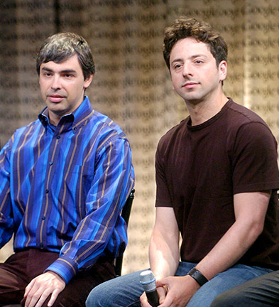
Google
The big innovation of the late 1990s is the development of search engines, which began with Alta Vista at DEC’s Western Research Lab and reaching its modern pinnacle with Google, which was founded by Stanford graduate students Larry Page and Sergey Brin in 1998.
Larry Page and Sergey Brin

Slide 46
Page Rank
The heart of the Google search engine is the page rank algorithm, which was described in a 1999 by Larry Page, Sergey Brin, Rajeev Motwani, and Terry Winograd.
The PageRank Citation Ranking:
Bringing Order to the Web
January 29, 1998
Abstract
The importance of a Webpage is an inherently subjective matter, which depends on the reader’s interests, knowledge and attitudes. But there is still much that can be said objectively about the relative importance of Web pages. This paper describes PageRank, a method for rating Web pages objectively and mechanically, effectively measuring the human interest and attention devoted to them.
We compare PageRank to an idealized random Websurfer. We show how to efficiently compute PageRank for large numbers of pages. And,we show how to apply PageRank to search and to user navigation.

Slide 47
Page Rank Algorithm
The page rank algorithm gives each page a rating of its importance, which is a recursively defined measure whereby a page becomes important if other important pages link to it.
One way to think about page rank is to imagine a random surfer on the web, following links from page to page. The page rank of any page is roughly the probability that the random surfer will land on a particular page. Since more links go to the important pages, the surfer is more likely to end up there.

Slide 48



Markov Processes
Google’s random surfer is an example of a Markov process, in which a system moves from state to state, based on probability information that shows the likelihood of moving from each state to every other possible state.
A simple example of a Markov process is illustrated by this table, which shows the likelihood of a particular weather pattern for tomorrow given the weather for today.
What, then, is the likely weather two days from now, given that you know what the weather looks like today?
What if you then repeat the process for ten days?
That far out, it doesn’t matter what today’s weather is.
The day after tomorrow will be
Ten days from now will be
Tomorrow will be
If today is
0.85
0.81
0.77
0.10
0.13
0.14
0.05
0.06
0.07
0.60
0.72
0.77
0.25
0.18
0.14
0.15
0.10
0.07
0.40
0.66
0.77
0.40
0.22
0.14
0.20
0.12
0.07

Slide 49
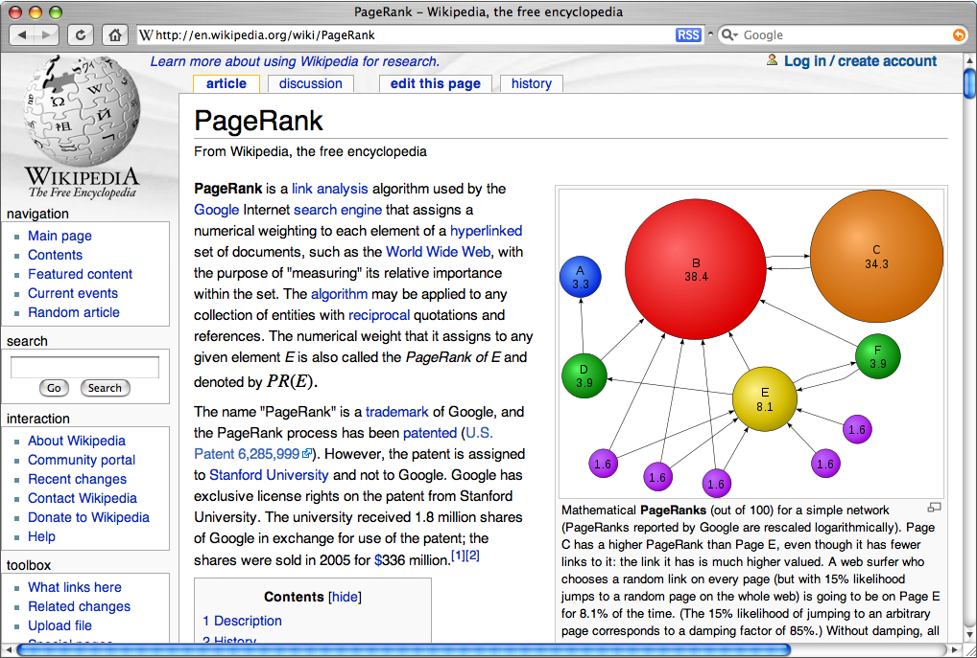
Google’s Page Rank Algorithm

Slide 50

The Page Rank Algorithm
1.
Start with a set of pages.
A
B
D
C
E

Slide 51
The Page Rank Algorithm
2.
Crawl the web to determine the link structure.
A
B
D
C
E

Slide 52
The Page Rank Algorithm
3.
Assign each page an initial rank of 1 / N.
A
B
0.2
0.2
D
0.2
C
E
0.2
0.2

Slide 53
The Page Rank Algorithm
4.
Successively update the rank of each page by adding up the weight of every page that links to it divided by the number of links emanating from the referring page.
In the current example, page E has two incoming links, one from page C and one from page D.
Page C contributes 1/3 of its current page rank to page E because E is one of three links from page C. Similarly, page D offers 1/2 of its rank to E.
The new page rank for E is
D
0.2
C
E
0.2
0.2
PR(C)
PR(D)
0.2
0.2
PR(E) =
+
=
+
≈
0.17
3
2
3
2

Slide 54
The Page Rank Algorithm
5.
If a page (such as E in the current example) has no outward links, redistribute its rank equally among the other pages in the graph.
In this graph, 1/4 of E’s page rank is distributed to pages A, B, C, and D.
The idea behind this model is that users will keep searching if they reach a dead end.
D
0.2
C
E
0.2
0.2

Slide 55
The Page Rank Algorithm
6.
Apply this redistribution to every page in the graph.
A
B
0.28
0.15
D
0.18
C
E
0.22
0.17

Slide 56
The Page Rank Algorithm
7.
Repeat this process until the page ranks stabilize.
A
B
0.26
0.17
D
0.17
C
E
0.23
0.16

Slide 57
The Page Rank Algorithm
8.
In practice, the Page Rank algorithm adds a damping factor at each stage to model the fact that users stop searching.
A
B
0.25
0.17
D
0.18
C
E
0.22
0.17
PR(A) = (1−d)/N+d(PR(B)/L(B)+PR(C)/L(C)+PR(D)/L(D)+PR(E)/N)

Slide 58
The End

